Slide 1
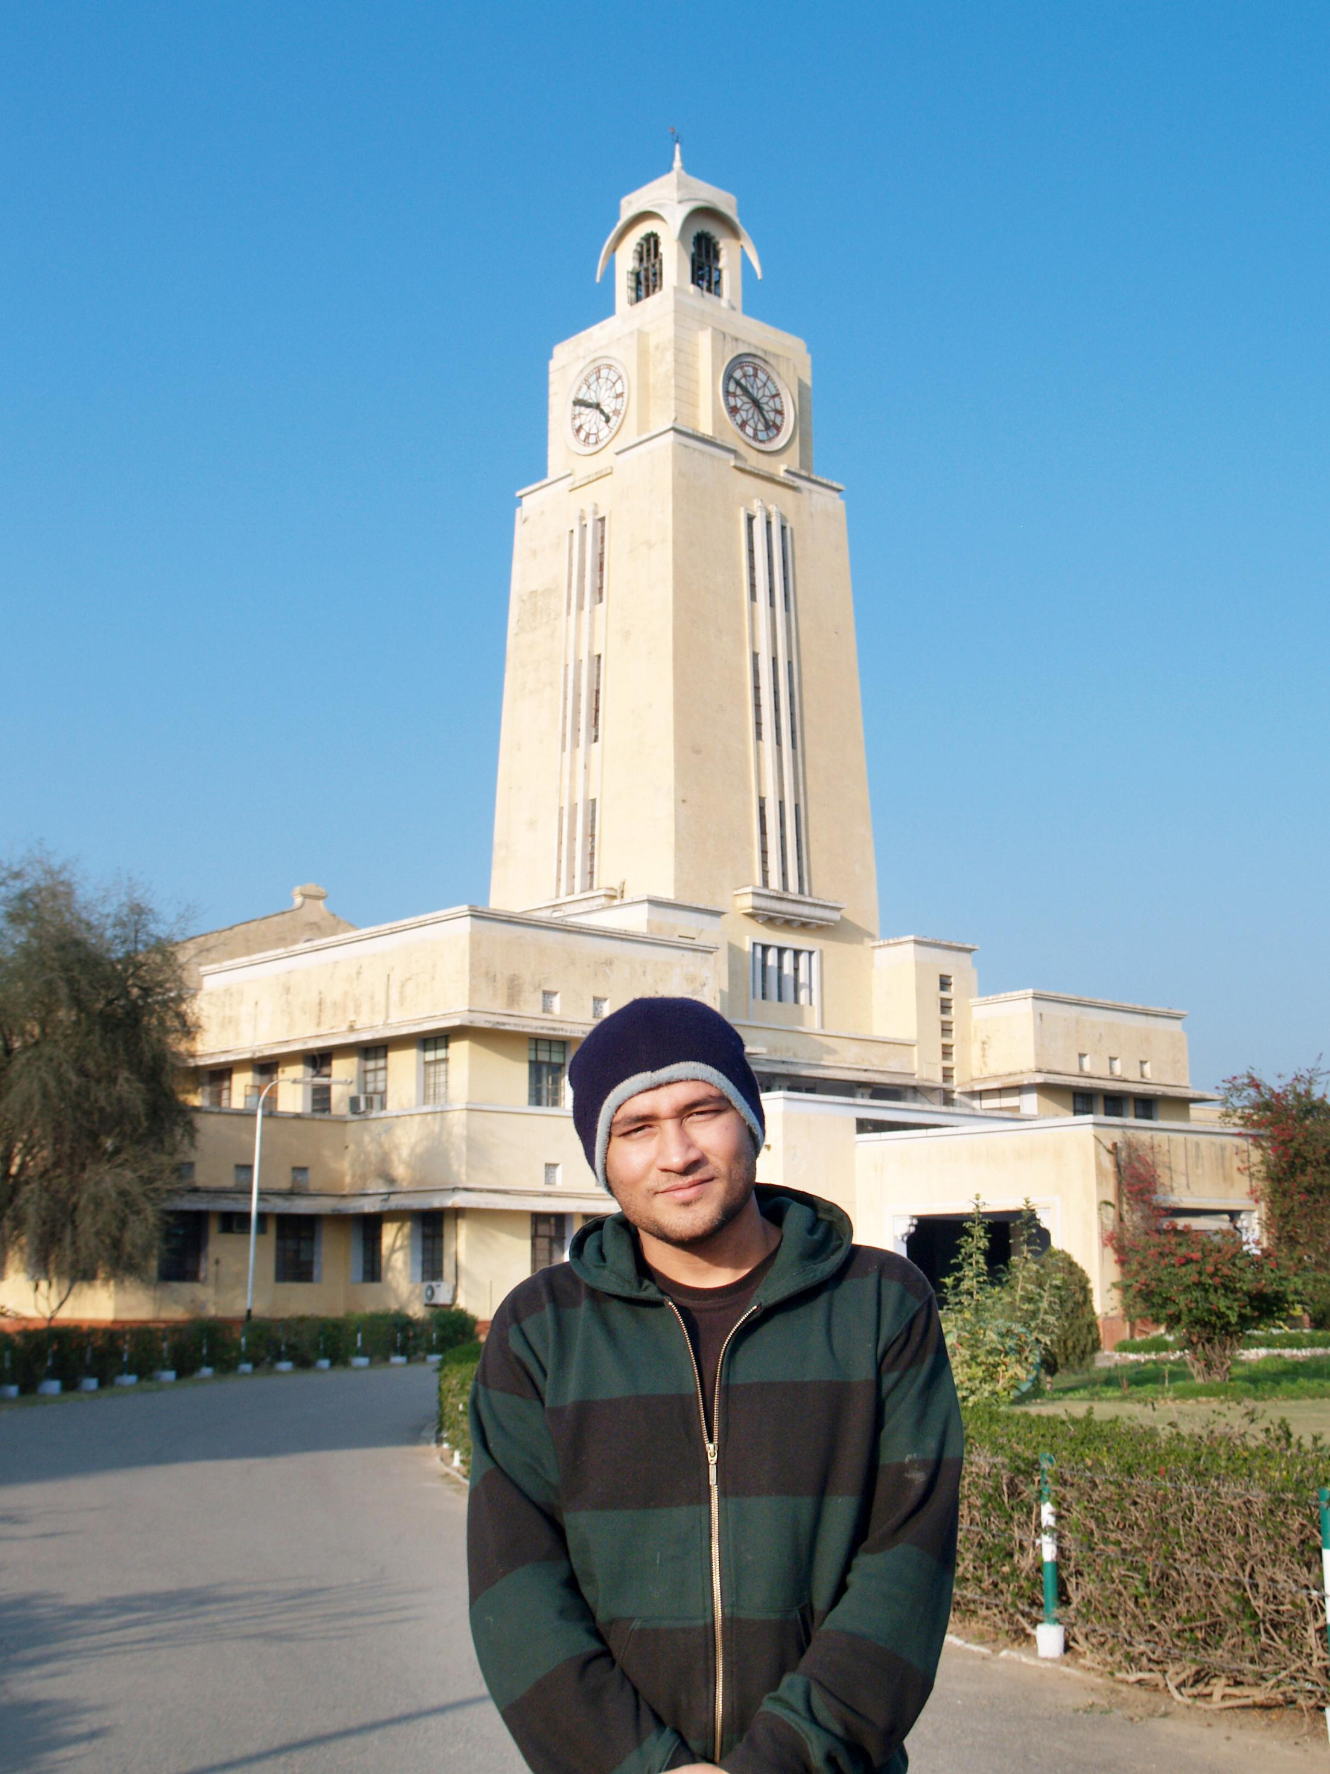



BITS Pilani
Pilani Campus
(some slides adapted from http://aima.cs.berkeley.edu/)
DSE CL 557 - Artificial and Computational Intelligence
#2. Intelligent Agents
Sunday, September 6, 2020
Dr. Saikishor Jangiti

Slide 2
Agenda
#1 Introduction
Foundations of AI
Brief Overview of Modern AI & Application Domains.
#2 Intelligent Agents
Agents and environments
Rationality
PEAS
(Performance measure, Environment, Actuators, Sensors)
Environment types
Agent types

Slide 3
Areas Contributing to AI
Philosophy
Mathematics
Economics
Neuroscience
Psychology
Computer Engineering
Control theory, Cybernetics
Linguistics

Slide 4
Areas Contributing to AI
Philosophy
Mathematics
Economics
Neuroscience
Psychology
Computer Engineering
Control theory, Cybernetics
Linguistics
Can formal rules be used to draw valid conclusions?
How does the mind arise from a physical brain?
Where does knowledge come from?
How does knowledge lead to action?

Slide 5
Areas Contributing to AI
Philosophy
Mathematics
Economics
Neuroscience
Psychology
Computer Engineering
Control theory, Cybernetics
Linguistics
Aristotle (384–322 B . C .) : first to formulate precise set of laws to govern rational part of brain
Ramon Lull (d. 1315) : useful reasoning could actually be carried out by a mechanical artifact
Hobbes (1588–1679) : “we add
and subtract in our silent thoughts.”
Leibniz (1646–1716) : Built a mechanical device intended to carry out operations on concepts rather than numbers

Slide 6
Areas Contributing to AI
Philosophy
Mathematics
Economics
Neuroscience
Psychology
Computer Engineering
Control theory, Cybernetics
Linguistics
Some ‘isms on the working of minds :
Rationalism - Correct Reasonings ( Aristotle, Descartes … )
Dualism - A part of the human mind (or soul or spirit) that is outside of nature
Materialism - Alternative to dualism - holds
that the brain’s operation according to the laws of physics constitutes the mind

Slide 7
Areas Contributing to AI
Philosophy
Mathematics
Economics
Neuroscience
Psychology
Computer Engineering
Control theory, Cybernetics
Linguistics
Obtaining Knowledge
David Hume’s (1711–1776) : First principles of induction
Logical positivism- Rudolf Carnap : Every knowledge obtained has a logical connection
Carnap (1905–1997) : A book “The Logical Structure of the World” (1928) defined an explicit computational procedure for extracting knowledge from elementary experiences

Slide 8
Areas Contributing to AI
Philosophy
Mathematics
Economics
Neuroscience
Psychology
Computer Engineering
Control theory, Cybernetics
Linguistics
Connection between knowledge and action:
Aristotle - (in De Motu Animalium) that actions are justified by a logical connection between goals and knowledge of the action’s outcome
I need covering;
a cloak is a covering. I need a cloak.
What I need, I have to make; I need a cloak.
I have to make a cloak.
And the conclusion, “I have to make a cloak” is an action

Slide 9
Areas Contributing to AI
Philosophy
Mathematics
Economics
Neuroscience
Psychology
Computer Engineering
Control theory, Cybernetics
Linguistics
What are the formal rules to draw valid conclusions?
What can be computed?
How do we reason with uncertain information?

Slide 10
Areas Contributing to AI
Philosophy
Mathematics
Economics
Neuroscience
Psychology
Computer Engineering
Control theory, Cybernetics
Linguistics
What are the formal rules to draw valid conclusions?
George Boole (1815–1864) : Propositional Logic
Gottlob Frege (1848–1925): First order logic

Slide 11
Areas Contributing to AI
Philosophy
Mathematics
Economics
Neuroscience
Psychology
Computer Engineering
Control theory, Cybernetics
Linguistics
What can be computed?
Kurt Gödel (1906–1978) : In any formal theory as strong as Peano arithmetic #(the elementary theory of natural numbers), there are true statements that are undecidable in the sense that they have no proof within the theory
Computability, tractability, NP-completeness Probability theory & inference mechanisms
# - https://en.wikipedia.org/wiki/Peano_axioms

Slide 12
Areas Contributing to AI
Philosophy
Mathematics
Economics
Neuroscience
Psychology
Computer Engineering
Control theory, Cybernetics
Linguistics
How should we make decisions so as to maximize payoff?
Utility / preferred outcomes
Decision theory -Probability & utility theory Game theory
How to make decisions when payoffs are not immediate?
Markov Decision Process

Slide 13
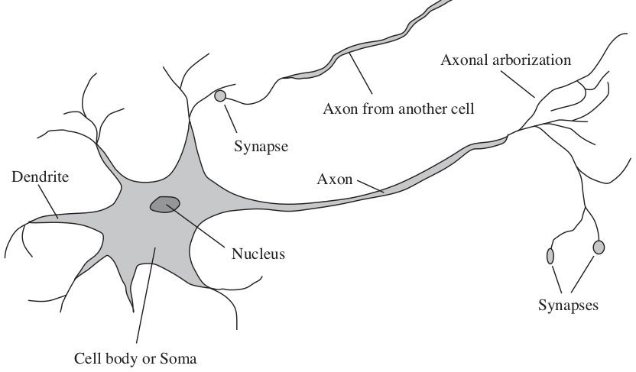
Areas Contributing to AI
Philosophy
Mathematics
Economics
Neuroscience
Psychology
Computer Engineering
Control theory, Cybernetics
Linguistics
How do brains process information?
Study of the nervous system / brain
How does brain enables thoughts - Mystery Still
Aristotle , “Of all the animals, man has the largest brain in proportion to his size”

Slide 14
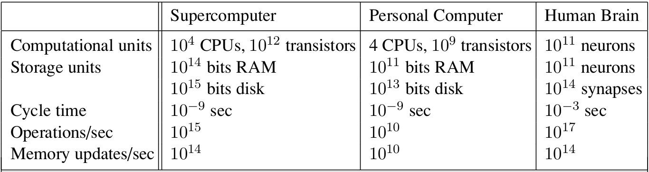
Areas Contributing to AI
Philosophy
Mathematics
Economics
Neuroscience
Psychology
Computer Engineering
Control theory, Cybernetics
Linguistics

Slide 15
Areas Contributing to AI
Philosophy
Mathematics
Economics
Neuroscience
Psychology
Computer Engineering
Control theory, Cybernetics
Linguistics
How do humans and animals think and act?
Cognitive Psychology - Brain as an information-processing device
Two months after the dartmouth workshop, a workshop in MIT gave birth to Cognitive Science
George Miller, Noam Chomsky, Allen Newell and Herbert Simon - roles of computer models to address the psychology of memory, language, and logical thinking, issues..
“a cognitive theory should be like a computer program” (Anderson, 1980);

Slide 16
Areas Contributing to AI
Philosophy
Mathematics
Economics
Neuroscience
Psychology
Computer Engineering
Control theory, Cybernetics
Linguistics
Computers & Programming Languages

Slide 17
Areas Contributing to AI
Philosophy
Mathematics
Economics
Neuroscience
Psychology
Computer Engineering
Control theory, Cybernetics
Linguistics
Control theory
Deals with the behaviour of dynamic systems
behaviour must ensure the error between the current state and goal state is minimized
Cybernetics - Book by Wiener
(Norbert Wiener, 1948) : Scientific study of control and communication in the animal and the machine
Ashby’s Design for a Brain (1948, 1952):
Intelligence could be created by the use of homeostatic devices containing appropriate feedback loops to achieve stable adaptive behavior
Led to the idea of design of systems that
maximize an objective function over time

Slide 18
Areas Contributing to AI
Philosophy
Mathematics
Economics
Neuroscience
Psychology
Computer Engineering
Control theory, Cybernetics
Linguistics
How does language relate to thought?
Verbal Behavior (1957, B. F. Skinner) :
Behaviorist approach to language learning
Reviewed by Noam Chomsky
criticised lack of notion of creativity in language
Syntactic Structures ( 1957, Noam Chomsky)
Computational linguistics / natural language processing as a part of AI
Understanding a language is realized as more complex than ever
Context, subject matter knowledge
complicated it further
Representing language consumed volume of work done in NLP, in early times

Slide 19


Deep Learning Breakthroughs (2012 – Present)
In 2012, deep learning beat previous benchmark in the ImageNet competition.
In 2013, deep learning is used to understand
“conceptual meaning” of words.
In 2014, similar breakthroughs appeared in language translation.
These have led to advancements in Web Search, Document Search, Document Summarization, and Machine Translation.
नमस्कार
“Hello”
Google Translate
*Other names and brands may be claimed as the property of others.
19

Slide 20
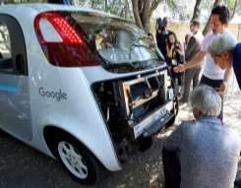


Modern AI (2012 – Present): Deep Learning Impact
Computer vision
Natural language
Self-driving cars: object detection
Healthcare: improved diagnosis
Communication: language translation
20

Slide 21









How is the AI of this Era is Different?
Faster Computers
Bigger
Datasets
Neural Nets
Cutting Edge Results in a Variety of Fields
21

Slide 22
Other Modern AI Factors
Continued expansion of open source AI, especially in Python*, aiding machine learning and big data ecosystems.
Leading deep learning libraries open-sourced, allowing further adoption by industry.
Open sourcing of large datasets of millions of labeled images, text datasets such as Wikipedia has also driven breakthroughs.
*Other names and brands may be claimed as the property of others.
30

Slide 23
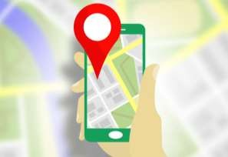

AI in Transportation
Navigation
Ride sharing
Uber & Lyft predict real-time demand using AI techniques, machine learning, deep learning.
Google & Waze find the fastest route, by processing traffic data.
23

Slide 24
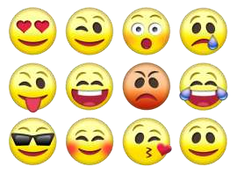

AI in Social Media
Audience
Content
Facebook & Twitter use AI to decide what content to present in their feeds to different audiences.
Image recognition and sentiment analysis to ensure that content of the appropriate “mood” is being served.
24

Slide 25
BITS Pilani
Pilani Campus
(some slides adapted from http://aima.cs.berkeley.edu/)
DSE CL 557 - Artificial and Computational Intelligence
#2. Intelligent Agents
Sunday, September 6, 2020
Dr. Saikishor Jangiti

Slide 26
Outline
Agents and environments
Rationality
PEAS
Performance measure
Environment
Actuators
Sensors
Environment types
Agent types

Slide 27
Agents
An agent is anything that can be viewed
as perceiving its environment through sensors
and acting upon that environment through actuators
Human agent:
eyes, ears, and other organs for sensors;
hands, legs, mouth, and other body parts for actuators
Robotic agent:
cameras and infrared range finders for sensors;
various motors for actuators

Slide 28
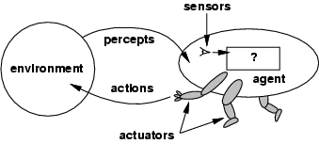
Agents and environments
The agent function maps from percept histories to actions:
[f: P* → A]
The agent program runs on the physical architecture to produce f
agent = architecture + program

Slide 29
Vacuum-cleaner world
Percepts: location and contents, e.g., [A , Dirty]
Actions: Left, Right, Suck, NoOp

Slide 30
A vacuum-cleaner agent

Slide 31
Rational agents
An agent should strive to "do the right thing",
based on what it can perceive and the actions it can perform.
The right action is the one that will cause the agent to be most successful
Performance measure: An objective criterion for success of an agent's behavior
E.g., performance measure of a vacuum-cleaner agent
amount of dirt cleaned up
amount of time taken
amount of electricity consumed
amount of noise generated, etc.

Slide 32
Rational agents
Rational Agent: For each possible percept sequence, a rational agent should select an action that is expected to maximize its performance measure, given the evidence provided by the percept sequence and whatever built-in knowledge the agent has.

Slide 33
Rational agents
Rationality is distinct from omniscience
Omniscience (all-knowing with infinite knowledge)
Agents can perform actions in order to modify future percepts so as to obtain useful information (information gathering, exploration)
An agent is autonomous if its behavior is determined by its own experience (with ability to learn and adapt)

Slide 34
PEAS
PEAS:
Performance measure
Environment
Actuators
Sensors

Slide 35
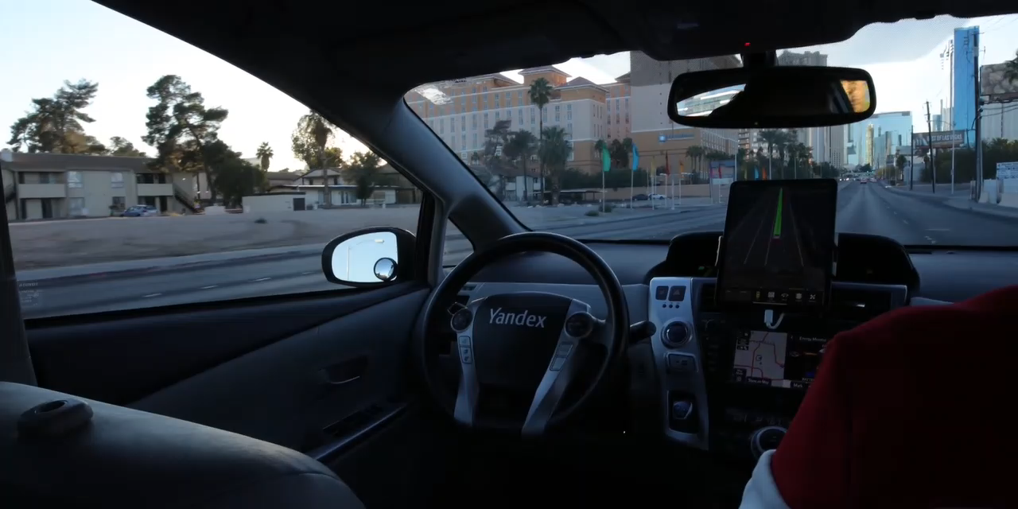
PEAS - Automated taxi driver
Performance measure: Safe, fast, legal, comfortable trip,
maximize profits
Environment: Roads, other traffic, pedestrians, customers
Actuators: Steering wheel, accelerator, brake, signal, horn
Sensors: Cameras, sonar, speedometer, GPS, odometer, engine sensors, keyboard

Slide 36
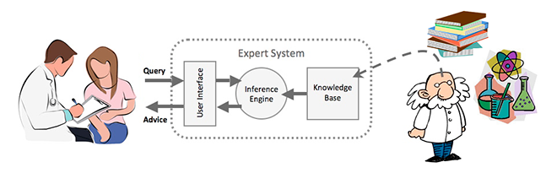
PEAS - Medical diagnosis system
Performance measure: Healthy patient, minimize costs, lawsuits
Environment: Patient, hospital, staff
Actuators: Screen display (questions, tests, diagnoses, treatments, referrals)
Sensors: Keyboard (entry of symptoms, findings, patient's answers)

Slide 37
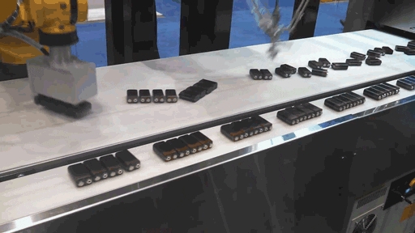
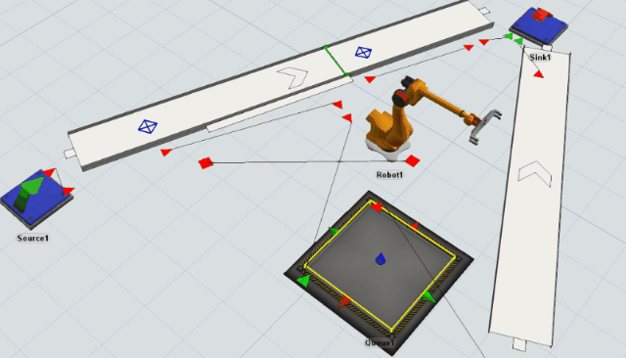
PEAS - Part-picking robot
Performance measure: Percentage of parts in correct bins
Environment: Conveyor belt with parts, bins
Actuators: Jointed arm and hand
Sensors: Camera, joint angle sensors

Slide 38

PEAS - Interactive English tutor
Performance measure: Maximize student's score on test
Environment: Set of students
Actuators: Screen display (exercises, suggestions, corrections)
Sensors: Keyboard

Slide 39
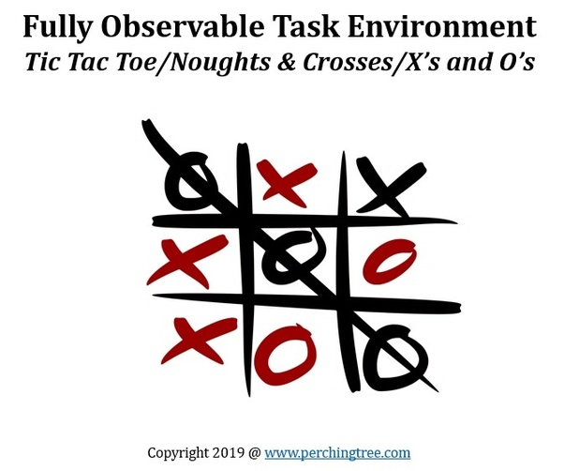
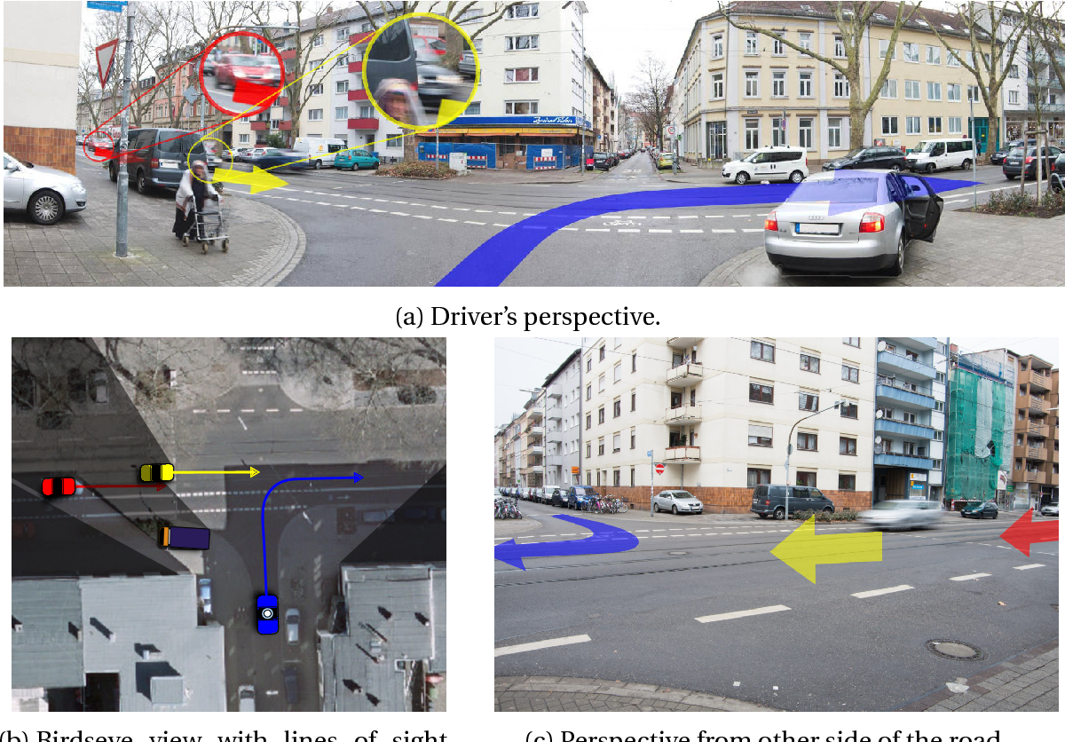
Environment types
Fully observable (vs. partially observable): An agent's sensors give it access to the complete state of the environment at each point in time.

Slide 40

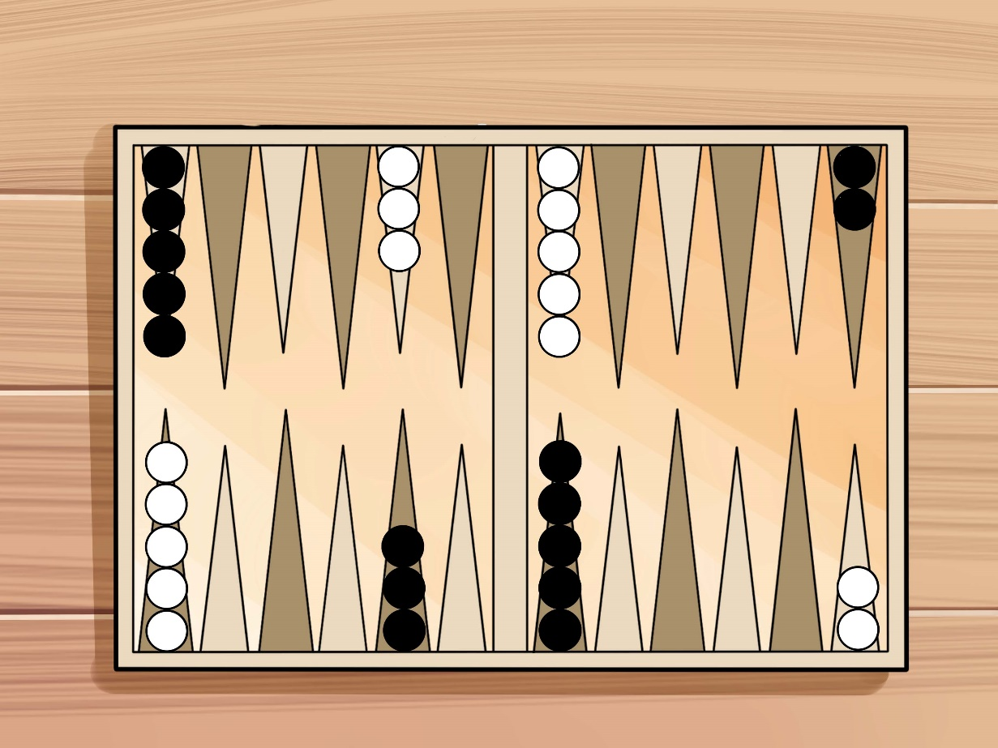
Environment types
Deterministic (vs. stochastic): The next state of the environment is completely determined by the current state and the action executed by the agent. (If the environment is deterministic except for the actions of other agents, then the environment is strategic)

Slide 41
Environment types
Episodic (vs. sequential): The agent's experience is divided into atomic "episodes" (each episode consists of the agent perceiving and then performing a single action), and the choice of action in each episode depends only on the episode itself.

Slide 42
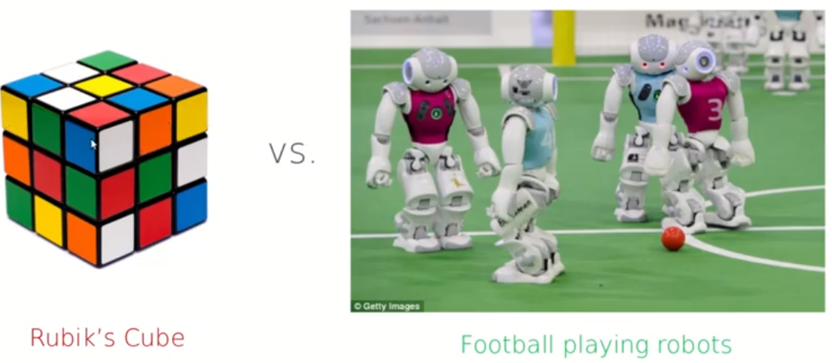
Environment types
Static (vs. dynamic): The environment is unchanged while an agent is deliberating. (The environment is semidynamic if the environment itself does not change with the passage of time but the agent's performance score does)

Slide 43
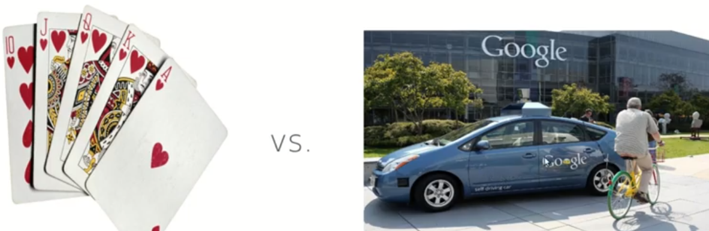
Environment types
Discrete (vs. continuous): A limited number of distinct, clearly defined percepts and actions.

Slide 44
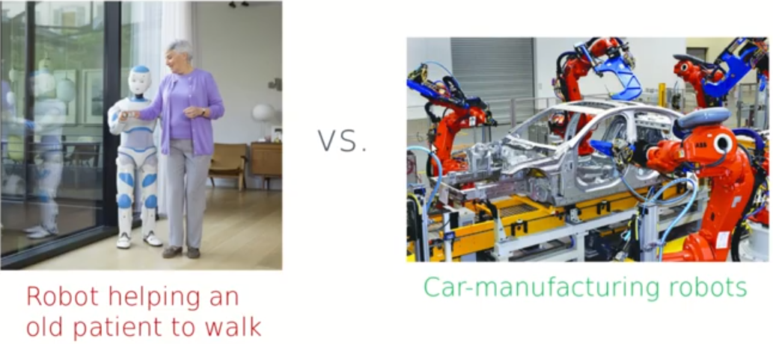
Environment types
Single agent (vs. multiagent): An agent operating by itself in an environment.

Slide 45
Environment types
The environment type largely determines the agent design
The real world is (of course) partially observable, stochastic, sequential, dynamic, continuous, multi-agent

Slide 46
Agent functions and programs
An agent is completely specified by the agent function mapping percept sequences to actions

Slide 47
Table-lookup agent
function TABLE-DRIVEN-AGENT(percept ) returns an action
persistent: percepts, a sequence, initially empty
table, a table of actions, indexed by percept sequences, initially fully specified
append percept to the end of percepts
action ←LOOKUP(percepts, table)
return action
Drawbacks:
Huge table
Take a long time to build the table
No autonomy
Even with learning, need a long time to learn the table entries

Slide 48
Agent types
Four basic types in order of increasing generality:
Simple reflex agents
Model-based reflex agents
Goal-based agents
Utility-based agents

Slide 49
Simple reflex agents

Slide 50
Simple reflex agents
function SIMPLE-REFLEX-AGENT(percept) returns an action
persistent: rules, a set of condition–action rules
state←INTERPRET-INPUT(percept)
rule←RULE-MATCH(state, rules)
action ←rule.ACTION
return action

Slide 51
Agent program for a vacuum-cleaner agent
function REFLEX-VACUUM-AGENT( [location,status]) returns an action
if status = Dirty then return Suck
else if location = A then return Right
else if location = B then return Left

Slide 52
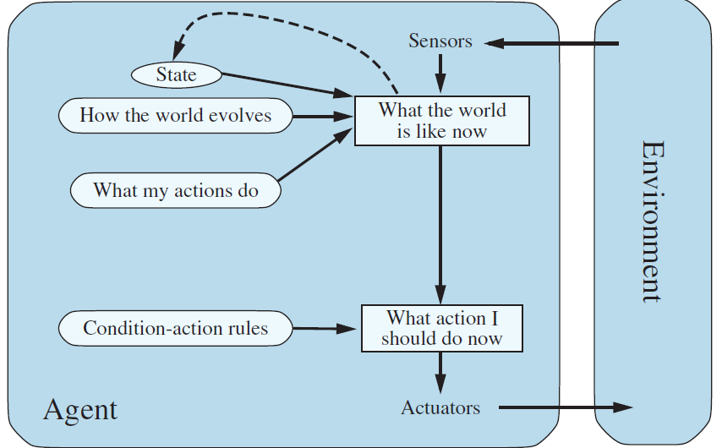
Model-based reflex agents

Slide 53
Model-based reflex agents
function MODEL-BASED-REFLEX-AGENT(percept) returns an action
persistent: state, the agent’s current conception of the world state
transition model, a description of how the next state depends on the current state and action
sensor model , a description of how the current world state is reflected in the agent’s percepts
rules, a set of condition–action rules
action, the most recent action, initially none
state←UPDATE-STATE(state, action, percept, transition model, sensor model )
rule←RULE-MATCH(state, rules)
action ←rule.ACTION
return action

Slide 54
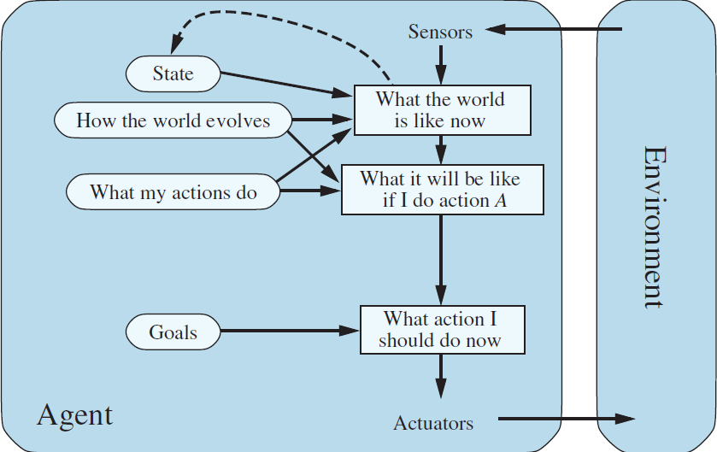
Goal-based agents

Slide 55
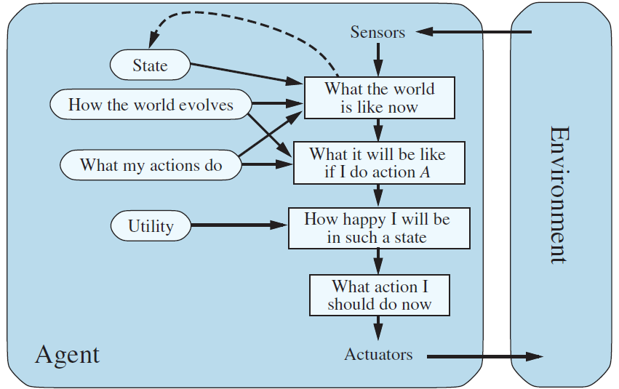
Utility-based agents

Slide 56
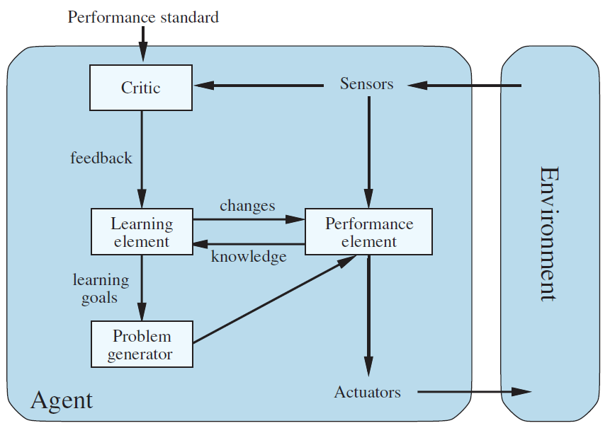
Learning agents

Slide 57
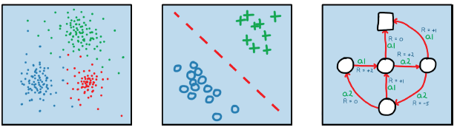
Three broad categories of ML
Machine Learning
Unsupervised
Learning
Supervised
Learning
Reinforcement
Learning

Slide 58
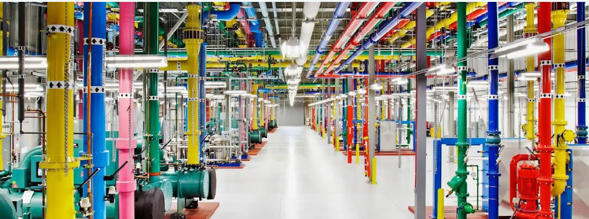
Google Data Centre Cooling
DeepMind AI Reduces Google Data Centre Cooling Bill by 40%

Slide 59
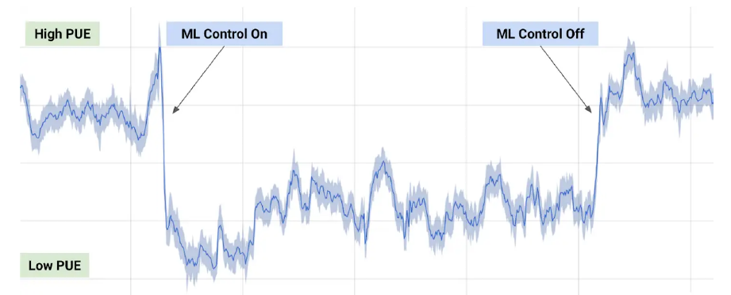
Google Data Centre Cooling
DeepMind AI Reduces Google Data Centre Cooling Bill by 40%

Slide 60
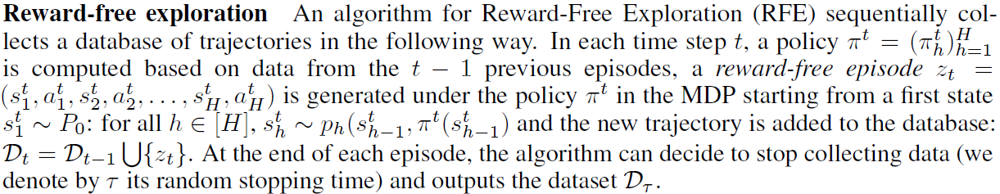
Google Data Centre Cooling
DeepMind AI Reduces Google Data Centre Cooling Bill by 40%
Optimal operation of pumps, chillers and cooling towers
Compared to five years ago, Google get around 3.5 times the computing power out of the same amount of energy
The sequence episode of actions from the start to the terminal state is an episode, or a trial
Reference: Emilie Kaufmann et al. Adaptive Reward-Free Exploration https://arxiv.org/pdf/2006.06294.pdf

Slide 61
Thank You
?
Any more Queries
Required Reading:
Note : Some of the slides are adopted from Prof. Vimal archives

